Slide 1
LCF East Bank Student Health and Safety Induction
September 2023

Slide 2
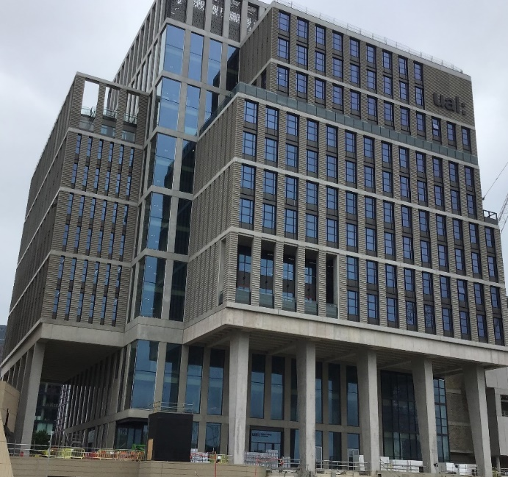
Welcome
At UAL your safety matters to us
Keeping safe at all times will help whilst on your creative learning journey at UAL and in your future career

Slide 3
Objectives

Slide 4
Objectives
Student responsibilities
Sources of Health and Safety information
Provision of Welfare Facilities and First Aid
Action to take in event of accidents, incidents, near misses
First Aid provisions
Fire Safety

Slide 5
Student Responsibilities

Slide 6
Student Responsibilities
Attend general health and safety induction training
Complete health and safety training specific to your course
Follow health and safety rules while you are on campus covered in Health and Safety inductions and training, and signs, posters, notices

Slide 7
Health and Safety Information

Slide 8
Health and Safety Information
Health and Safety Induction
Big Welcome videos
Student handbook
Course based

Slide 9
Additional Health and Safety Information
Specific inductions and signage, posters, notices
Fire safety information
Studios and workshops for the use of the area, equipment, machinery, chemicals
Guidance
Shows and events
Information can also be accessed via UAL website

Slide 10
Welfare Facilities

Slide 11
Welfare Facilities
Toilets on each level
Drinking water
Quiet rooms and Multi faith room on tenth floor
Café on ground floor and canteen on tenth floor
Safe bike storage on lower ground and showers

Slide 12
Accidents, Incidents & Near misses

Slide 13
Accident, Incidents & Near misses
Let your course leader, tutor or a member of staff know
Report accidents, incidents, near misses and health and safety concerns
Confidential reporting facility (Tell Someone) which can be used for this purpose.

Slide 14
First Aid

Slide 15
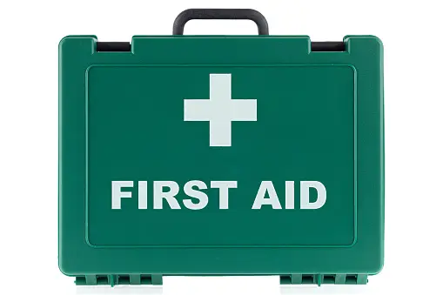
First Aid
There are trained First Aiders - call down to reception
First Aid boxes are located on each level
Defibrillator (AED) – main reception
Medical room (First Aid room) is on Lower ground mezzanine level

Slide 16
Fire Safety

Slide 17
Fire Safety Reminders
Non-smoking site including e-cigarettes and vaping you must go off site away from the building to smoke
Maintain good housekeeping and remove all waste
Fire doors should not be wedged open
Keep escape routes clear

Slide 18
Fire Safety Reminders
Weekly fire alarm testing will take place every Tuesday. Signs will be displayed to confirm the time – 10:00 or 14:00
There will be planned fire drills once a term to enable all to practice evacuation

Slide 19
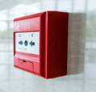
Fire Safety
If you discover a fire or one is reported to you:
Activate fire alarm (if not already sounding) by pushing the break glass call point located in lift lobbies

Slide 20
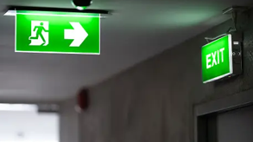
Fire Safety
On hearing the Fire Alarm
Leave immediately following the fire exit signs using nearest escape route
Leave all items behind
Move away from building for a minimum of 20 minutes

Slide 21
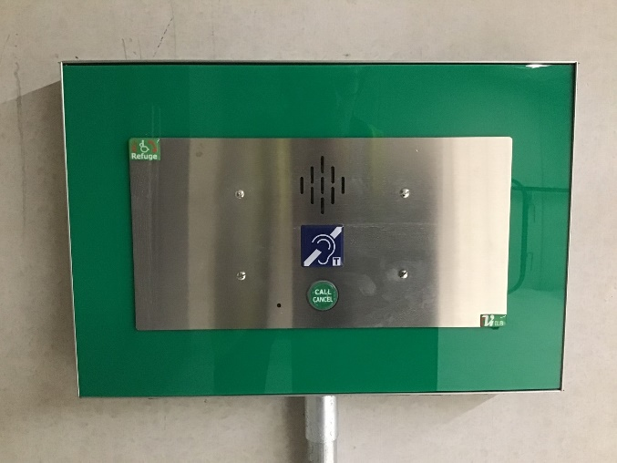
Fire Safety
Do not fight the fire
If you require assistance to evacuate go to refuge area located in stair core
Use the Emergency Voice Control (EVC) system to contact the Fire Command Centre for help with evacuation

Slide 22
Fire Safety
A digital messaging alert system is installed to receive notification that the fire alarm has been activated via your mobile phone
If required, then text message “UAL xxxxx” should be sent to 07860 000000 to register your mobile details and begin receiving notifications

Slide 23
Fire Safety
If you require additional support with evacuation please speak to your course leader to identify if a Personal Emergency Evacuation Plan (PEEP) is required

Slide 24
Any questions ?

Slide 25
Thank you

